Slide 1
LUL Youth Development and Education Project
JKL Systems

Slide 2
Overview
Team Introduction
Current vs. To-Be System
Areas of Opportunity
Feasibility Analysis (Economic, Technical, Organizational)
Prototypes (Mockup Forms)
Business Values
The Next Step
Notes:
Josh

Slide 3
As-Is vs To-Be System
As-Is:
To-Be:
Begin Program
Begin Program
Program Coordinators Enter Attendance into Excel (Manually)
Enter Attendance into a Shared Database
Excel Reports Emailed to Imani Muhammad
Sr. Director (Kevin) Pulls Program Services Report
Numbers Entered into Program Services Report (Manually)
Sends Report to Potential and Existing Donors
Email Updated Excel Reports back to Program Coordinators
Send Reports to Board of Directors, Potential, and Existing Donors
Notes:
Kelli

Slide 4
Areas of Opportunity
Efficiency in reporting
Data input (7-8 hours per week being used up)
Decentralized data storage (24 hours or greater response time)
Potential loss of grant funding (possibly losing 5 grants/yr)
Use of current resources (use up 1 box of paper and 1 toner every other month)
Notes:
Kelli
6 hours could be used to contact additional potential donors and generate additional revenue
Centralizing data causes instantaneous retrieval of data. Time can be focused on generating donations.
Paper (Two boxes per month @ 37.99 per box) AND Toner (Two cartridges per month @ $100 per cartridge)

Slide 5
Technical Feasibility
Low risk regarding familiarity
Project size considered low risk
No compatibility issues should exist
Organizational Feasibility
Low risk; users are trainable and have ability to adapt to new system
Notes:
Kelsi

Slide 6
Economic Feasibility
Notes:
Leslie

Slide 7
Notes:
Leslie

Slide 8
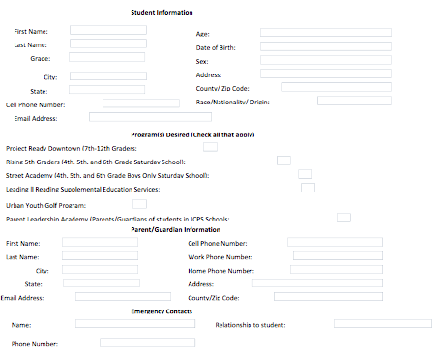
Notes:
Jake

Slide 9
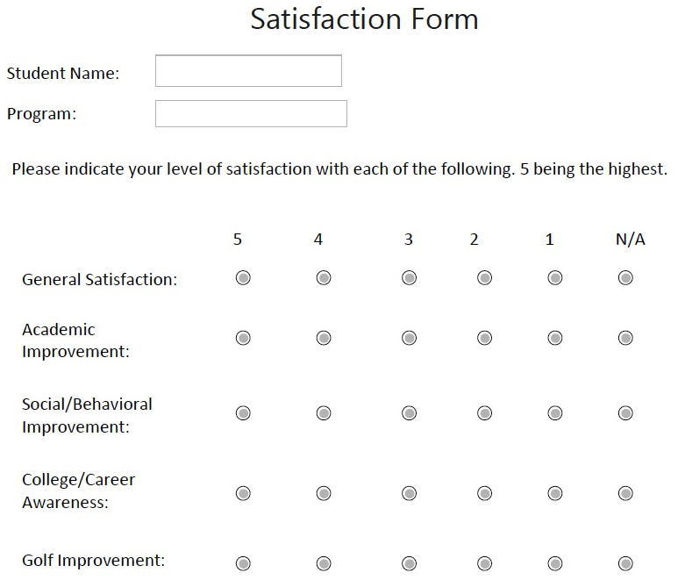
Notes:
Jake

Slide 10
Business Values
Use of time: Reduced manual data processing (could spend additional 7-8 hrs per week trying to generate donations)
Increase Grant Funding due to better process for tracking program data (may generate $24,000 additional grants)
Develop new programs (may create 1-2 additional programs)
Utilization of resources (could save $828/yr on paper and toner)
Notes:
Jake

Slide 11
Recap
Current vs. To-Be System
Areas of Opportunity
Feasibility Analysis (Economic, Technical, Organizational)
Prototypes (Mockup Forms)
Business Values
Notes:
Josh

Slide 12
The Next Step…
Consider how to implement new system
Refine “To-Be” system process flows
In-depth analysis on initial architecture considerations
Notes:
Josh

